Slide 1
Homework Assignment #1
Socket Programming with UDP &TCP

Slide 2
Outline
Socket
Socket API
Socket Example
Homework Assignment #1

Slide 3
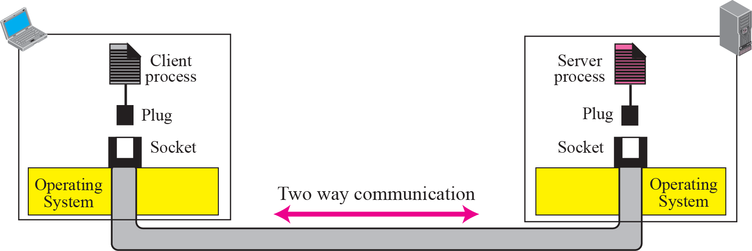
Socket
It was first developed at the University of California, Berkeley for use on Unix systems
  Berkeley socket
All modern operating systems now have some implementation of the Berkeley socket interface
  Became the standard interface for connecting to the Internet
To allow communications between hosts or between processes on one computer
Concepts of sockets

Slide 4
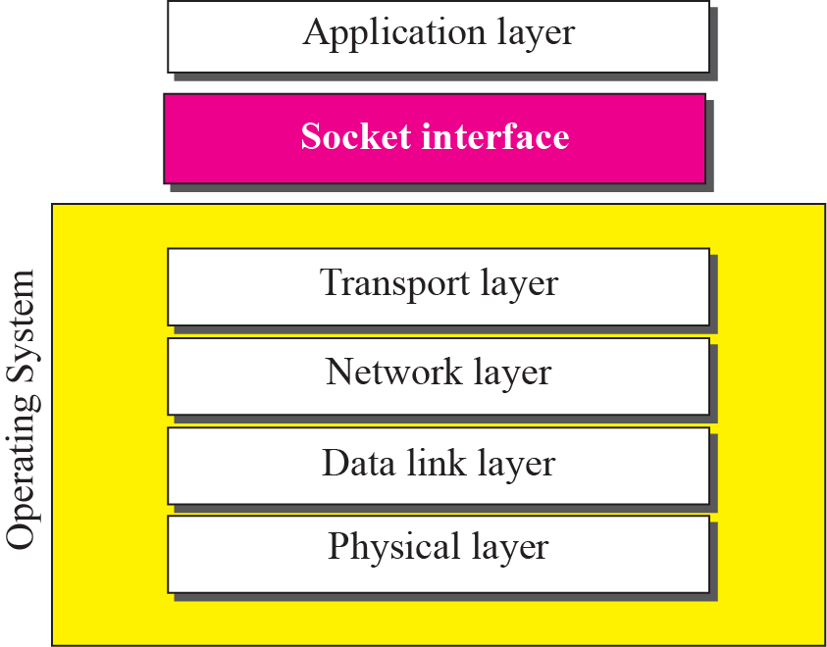
Socket(cont.)
Relation between the operating system and the TCP/IP suite

Slide 5
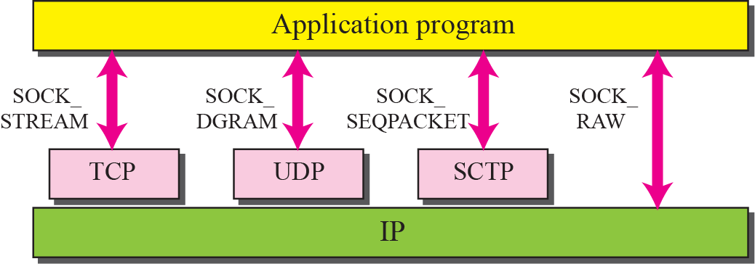
Socket(cont.)
Socket types

Slide 6
Outline
Socket
Socket API
Socket Example
Homework Assignment #1

Slide 7
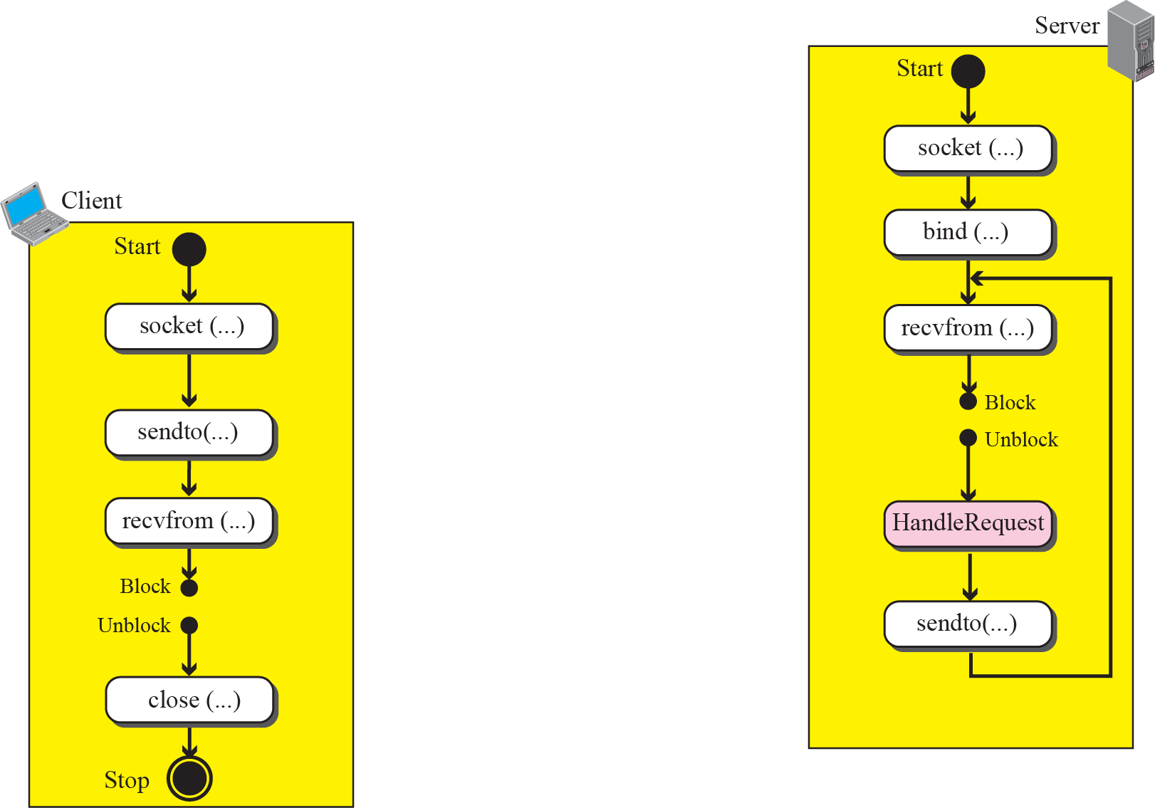
Socket API (UDP)
Connectionless iterative communication using UDP

Slide 8


Socket API (TCP)
socket()
socket()
bind()
listen()
connect()
Three-Way Handshake
accept()
send()
recv()
recv()
send()
close()
EOF
recv()

Slide 9


Socket API(TCP cont.)
socket
connect(blocks)
(active open)
SYN1
(SEQ1=100,ACK=0)
socket、bind、listen
(passive open)
accept(blocks)
SYN2+ACK1
(SEQ2=300,ACK1=101)
connect returns
ACK2
(SEQ1=101,ACK2=301)
accept returns
Recv(blocks)

Slide 10
Socket API (cont.)
socket
  Create a descriptor for use in network communication
#include <sys/type.h>
#include <sys/socket.h>
int socket(int domain, int type, int protocol);
EX: sock = socket(PF_INET, SOCK_DGRAM, 0);
domain:
PF_UNIX: Protocol Family is UNIX
(for local communication)
PF_INET: Protocol Family is IPv4
PF_INET6:Protocol Family is IPv6
type:
SOCK_STREAM: TCP
SOCK_DGRAM: UDP
SOCK_SEQPACKET: SCTP
SOCK_RAW
protocol:
0 ~ 255
  (ref. /etc/protocols. The value 0 may be used to select a default protocol from the selected domain and type)
return value:
successful:
    return a non-negative integer, socket descriptor (sd)
otherwise return -1

Slide 11
Socket API (cont.)
AF_xxx Versus PF_xxx
  The "PF_" prefix stands for "protocol family“ and the "AF_" prefix stands for "address family"
  The PF_ value was computer network programming used to create the socket and the AF_ value was used in socket address structures

Slide 12
Socket API (cont.)
htons
  Convert the unsigned short integer host short from host byte order to network byte order
Byte order
  Little endian
  Big endian
#include <arpa/inet.h>
uint16_t htons(uint16_t hostshort);
EX: address.sin_port = htons(5555);

Slide 13
Socket API (cont.)
bzero
  Set the first n bytes of the area starting at s to zero (bytes containing '\0')
inet_addr
  Convert the Internet host address cp from IPv4 numbers-and-dots notation into binary data in network byte order
#include <string.h>
void bzero(char *s, int n);
EX: bzero(&Address, sizeof(Address));
#include <sys/socket.h>
#include <netinet/in.h>
#include <arpa/inet.h>
in_addr_t inet_addr(const char *cp);
EX: address.sin_addr.s_addr = inet_addr(“140.120.15.242”);

Slide 14
Socket API (cont.)
bind
  Bind a local IP address and protocol port to a socket
#include <sys/socket.h>
#include <netinet/in.h>
int bind(int sd, struct sockaddr *address, int address_length);
EX:
struct sockaddr_in Address;
bind(sock,(struct sockaddr *)&Address, sizeof(Address))

Slide 15
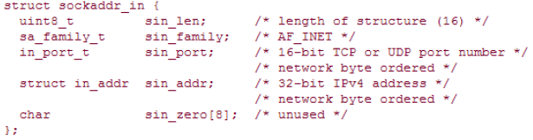
Socket API (cont.)
IPv4 Socket Address Structure
  Each supported protocol suite defines its own socket address structure
  The names of these structures begin with sockaddr_ and end with a unique suffix for each protocol suite
  An IPv4 socket address structure, commonly called an "Internet socket address structure," is named sockaddr_in and is defined by including the <netinet/in.h> header

Slide 16


Socket API (cont.)
Generic Socket Address Structure - Sockaddr
  Define a generic socket address structure in the <sys/socket.h> header
  This requires that any calls to these functions must cast the pointer to the protocol-specific socket address structure to be a pointer to a generic socket address structure
  For example,

Slide 17
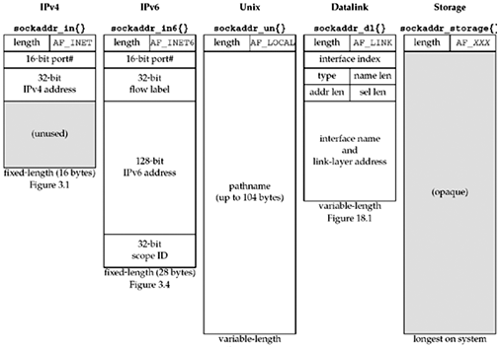
Socket API (cont.)
Comparison of Socket Address Structures

Slide 18
Socket API (cont.)
For UDP
recvfrom
  Receive a message from a socket
sendto
  Send a message on a socket
#include <sys/socket.h>
int recvfrom(int sd, void *buffer, int message_length, int flags,
struct sockaddr *address, int *address_length);
EX: byte_recv = recvfrom(sock, buffer, sizeof(buffer), 0, (struct sockaddr *)&Address, &sizeof(Address));
#include <sys/socket.h>
int sendto(int sd, void *buffer, int message_length, int flags,
struct sockaddr *address, int address_length);
EX: byte_sent = sendto(sock, buffer, sizeof(buffer), 0, (struct sockaddr *)&Address, sizeof(Address));

Slide 19
Socket API (cont.)
For TCP
listen
  Is used by a server to convert an unconnected socket into a passive socket
#include <sys/socket.h>
int listen(int socket_descriptor, int backlog);
EX: listen( sock, 20);
backlog:
It specifies the maximum number of connections the kernel
should queue for this socket

Slide 20
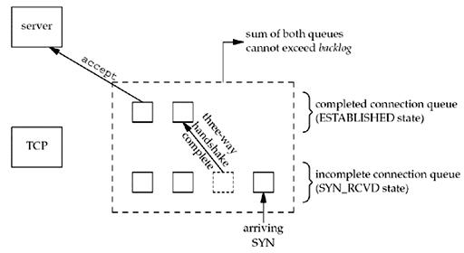
Socket API (cont.)
For TCP
listen(cont.)
  Backlog(cont.)
The two queues maintained by TCP for a listening socket

Slide 21
Socket API (cont.)
For TCP
accept
  Is called by a TCP server to return the next completed connection from the front of the completed connection queue
connect
  Is used by a client to establish a connection with a server via a 3-way handshake
#include <sys/socket.h>
int accept(int socket_descriptor, struct sockaddr* addr, int* addrlen);
EX: recfd = accept ( sock, (struct sockaddr *)&client_addr, &client_addr_length );
#include <sys/socket.h>
int connect(int socket_descriptor, const struct sockaddr* addr, int addrlen);
EX: connect ( sock, (struct sockaddr *)&server_addr, server_addr_length );

Slide 22
Socket API (cont.)
For TCP
recv
  Receive data on a socket
send
  Send data out over a socket
#include <sys/socket.h>
int recv(int socket_descriptor, char* buf, int len, int flags);
EX: byte_recv = recv(recvfd, buffer, sizeof(buffer), 0);
#include <sys/socket.h>
int send(int socket_descriptor, const char* buf, int len, int flags);
EX: byte_sent = send(sock, buffer, sizeof(buffer), 0);

Slide 23
Socket API (cont.)
close
  Terminate communication and deallocate a descriptor
#include <unistd.h>
int close(int sd);
EX: close(sock);

Slide 24
Outline
Socket
Socket API
Socket Example
Homework Assignment #1

Slide 25
Socket Example
Using UDP - Client
#include <stdio.h>
#include <stdlib.h>
#include <string.h> //for bzero()
#include <unistd.h> //for close()
#include <sys/types.h>
#include <sys/socket.h>
#include <netinet/in.h>
#define Server_PortNumber 5555
#define Server_Address "140.120.15.242"
int main(int argc, char *argv[]) {
struct sockaddr_in address;
int sock, byte_sent;
char buffer[6]="hello\0";

Slide 26
Socket Example (cont.)
Using UDP – Client
sock = socket(PF_INET, SOCK_DGRAM, 0);
if (sock < 0) printf("Error creating socket\n");
bzero(&address, sizeof(address));
address.sin_family = AF_INET;
address.sin_port = htons(Server_PortNumber);
address.sin_addr.s_addr = inet_addr(Server_Address);
int address_length = sizeof(address);
byte_sent = sendto(sock, buffer, sizeof(buffer), 0, (struct sockaddr *)&address, address_length);
if (byte_sent < 0) printf("Error sending packet\n");
close(sock);
return 0;
}

Slide 27
Socket Example (cont.)
Using UDP - Server
#include <stdio.h>
#include <stdlib.h>
#include <string.h> //for bzero()
#include <unistd.h> //for close()
#include <sys/types.h>
#include <sys/socket.h>
#include <netinet/in.h>
#define PortNumber 5555
int main(int argc, char *argv[]) {
struct sockaddr_in address, client_address;
int sock, byte_recv, client_address_length;
char buffer[50];
sock = socket(PF_INET, SOCK_DGRAM, 0);
if (sock < 0) printf("Error creating socket\n");

Slide 28
Socket Example (cont.)
Using UDP - Server
bzero(&address, sizeof(address));
address.sin_family = AF_INET;
address.sin_port = htons(PortNumber);
address.sin_addr.s_addr = INADDR_ANY;
/*#define INADDR_ANY ((unsigned long int) 0x00000000)
INADDR_ANY allows the server to accept a client connection on any interface, in case the server host has multiple interfaces.*/
if (bind(sock,(struct sockaddr *)&address, sizeof(address)) == -1) {
printf("error binding\n");
close(sock);}
int address_length = sizeof(address);
for()
byte_recv = recvfrom(sock, buffer, sizeof(buffer), 0, (struct sockaddr
*)&client_address, &client_address_length);
if (byte_recv < 0) printf("Error recving packet\n");
printf("data: %s\n",buffer);} }

Slide 29
Socket Example
Using TCP - Client
#include <stdio.h>
#include <stdlib.h>
#include <string.h> //for bzero()
#include <unistd.h> //for close()
#include <sys/types.h>
#include <sys/socket.h>
#include <netinet/in.h>
#define Server_PortNumber 5555
#define Server_Address "140.120.15.242"
int main(int argc, char *argv[]) {
struct sockaddr_in server_addr;
int sock, byte_sent, server_addr_length = sizeof(server_addr);
char buffer[6]="hello\0";

Slide 30
Socket Example (cont.)
Using TCP – Client
sock = socket(PF_INET, SOCK_STREAM, 0);
if (sock < 0) printf("Error creating socket!\n");
bzero(&server_addr, server_addr_length);
server_addr.sin_family = AF_INET;
server_addr.sin_port = htons(Server_PortNumber);
server_addr.sin_addr.s_addr = inet_addr(Server_Address);
if (connect(sock, (struct sockaddr *)&server_addr,server_addr_length)==-1) {
printf("connect failed!");
close(sock);}
byte_sent = send(sock, buffer, sizeof(buffer),0);
if (byte_sent < 0) printf("Error sending packet!\n");
close(sock);
return 0;}

Slide 31
Socket Example (cont.)
Using TCP - Server
#include <stdio.h>
#include <stdlib.h>
#include <string.h> //for bzero()
#include <unistd.h> //for close()
#include <sys/types.h>
#include <sys/socket.h>
#include <netinet/in.h>
#define PortNumber 5555
int main(int argc, char *argv[]) {
struct sockaddr_in server_addr,client_addr;
int sock, byte_recv, server_addr_length = sizeof(server_addr), client_addr_length=sizeof(client_addr), recfd;
char buffer[50];
sock = socket(PF_INET, SOCK_STREAM, 0);
if (sock < 0) printf("Error creating socket\n");

Slide 32
Socket Example (cont.)
Using TCP - Server
bzero(&server_addr, server_addr_length);
server_addr.sin_family = AF_INET;
server_addr.sin_port = htons(PortNumber);
server_addr.sin_addr.s_addr = INADDR_ANY;
/*#define INADDR_ANY ((unsigned long int) 0x00000000)
INADDR_ANY allows the server to accept a client connection on any interface, in case the server host has multiple interfaces.*/
if (bind(sock,(struct sockaddr *)&server_addr, server_addr_length) == -1) {
printf("error binding!\n");
close(sock);}
if (listen(sock, 20) == -1) {
printf("listen failed!\n");
close(sock);}

Slide 33
Socket Example (cont.)
Using TCP - Server
if((recfd = accept(sock,(struct sockaddr *)&client_addr,&client_addr_length))==-1) {
printf("accept failed!\n");
close(sock);}
byte_recv = recv(recfd, buffer, sizeof(buffer),0);
if (byte_recv < 0) printf("Error recving packet\n");
printf("data: %s\n",buffer);
}

Slide 34
Outline
Socket
Socket API
Socket Example
Homework Assignment #1

Slide 35
Homework Assignments #1
Basic: Socket Programming with UDP & TCP (75 pts)
  UDP Socket Programming: send/receive UDP packets.
  TCP Socket Programming: send/receive TCP packets
Advanced:
  Measure the latency of UDP and TCP packets, respectively (10 pts)
  Measure the throughput (Mbps) by using UDP and TCP sockets, respectively (15 pts)

Slide 36
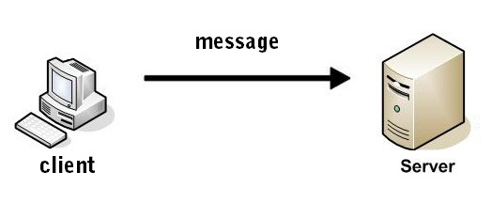

Homework Assignment #1
Basic: (75 pts)
In this work, you are asked to learn UDP/TCP socket programming
  UDP sockets
    The Client sends one UDP or TCP packet to the server
    After receiving the packet, the server send back an UDP or TCP packet to the client
  TCP sockets
    The Client sends one UDP or TCP packet to the server
    After receiving the packet, the server send back an UDP or TCP packet to the client

Slide 37
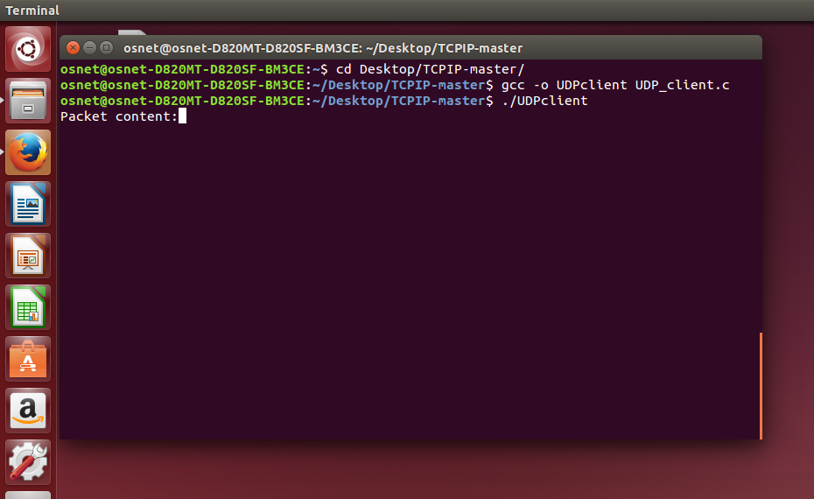
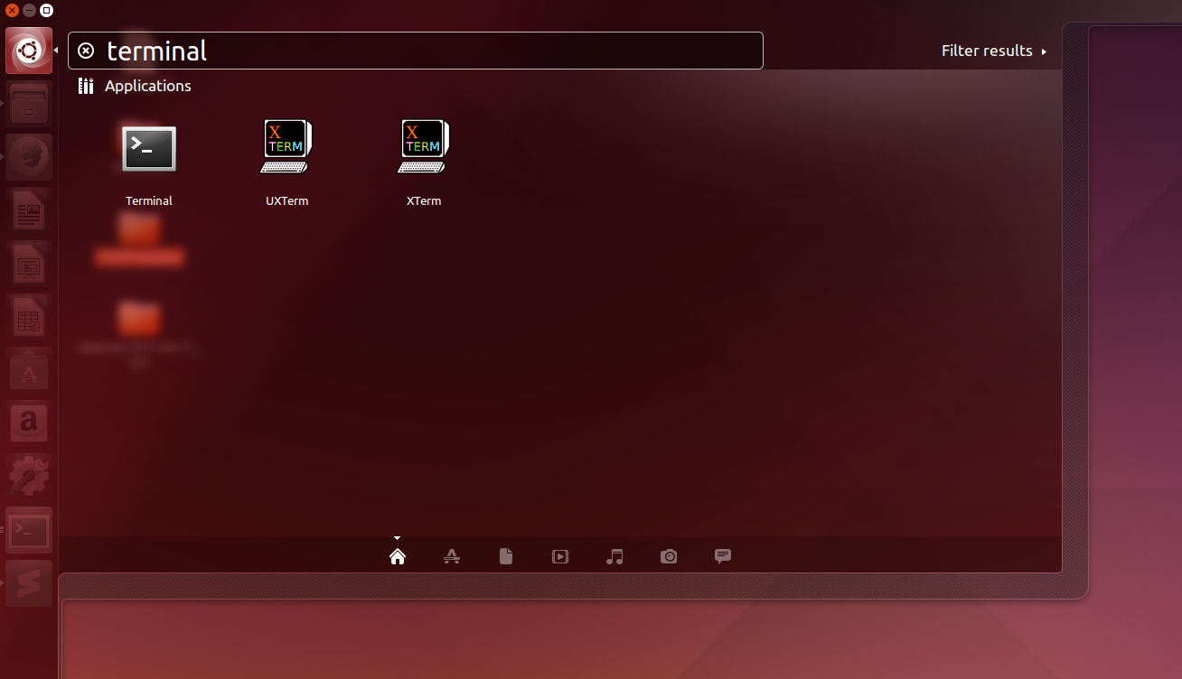
Executable Command(Client)
Client send a packet to server, then receive a packet from server
  User can input a string
ex:
$ ./client
Packet content: Hi, I’m 7105056035 //User input
Server response: Welcome! //Server’s response

Slide 38
Executable Command(Server)
Server receive a packet from client
  Then server will response 「welcome」 message to client
ex:
$ ./server
Received packet: Hi, I’m 7105056035 //This is received from client
Note
Please use Linux platform
Make sure that all necessary header file be included

Slide 39
Homework Assignment #1: Advanced (25 pts)
Measuring Latency (10 pt)
  UDP sockets
    Client sends UDP packets to server
    Measure the send latency
  TCP sockets
    Client sends TCP packets to the server
    Measure the send latency
Note: How to make your measurement accurately?
  Please describe your method in the word file

Slide 40
Homework Assignment #1: Advanced (25 pts)
Measuring throughput (15 pt)
  UDP sockets
    Client sends UDP packets to server
    Measure the send throughput
  TCP sockets
    Client sends TCP packets to the server
    Measure the send throughput
Note: How to make your measurement accurately?
  Please describe your method in the word file

Slide 41
Hint: gettimeofday()
gettimeofday
  Get the time as well as a timezone
#include <sys/time.h>
int gettimeofday(struct timeval *tv, struct timezone *tz);
struct timeval {
time_t tv_sec; /* seconds */
suseconds_t tv_usec; /* microseconds */
};
struct timezone {
int tz_minuteswest; /* minutes west of Greenwich */
int tz_dsttime; /* type of DST correction */
};

Slide 42
Hint: gettimeofday() (cont.)
ex:
  int main()
  {
  struct timeval start;
  struct timeval end;
  unsigned long diff;
  gettimeofday(&start,NULL);
  delay(10);
  gettimeofday(&end,NULL);
  diff = 1000000 * (end.tv_sec-start.tv_sec)+ end.tv_usec-start.tv_usec;
  printf("the difference is %ld (ms)\n”, diff);
  return 0;
  }

Slide 43
Turn in
Deadline
2019/03/27 PM.11:59:59
Upload to ilearning
File name
  HW1_ID.zip (e.g. HW1_7105056035.zip)
    Source code
      .c file
    Word
If you want to update
  HW1_ID_New1.zip, HW1_ID_New2.zip….etc
If you don’t hand in your homework on time, your score will be deducted 10 points every day.

Slide 44
TA
Name: 吳宜芬
Email: emma62042@gmail.com
  Title format: TCP/IP HW# - [your name]
Lab: OSNET(1001)

Slide 45

ANY QUESTION?

